Slide 1
Azure Overview
Dan Rey
drey@directionstraining.com
Technical Trainer | MCT

Slide 2
Azure Roadmap Taxonomy
Preview feature complete, recommended for production use, may not be available to all the customers in a region, excluded from SLA.
GA (Generally Available) to all customers in a region, starting to rollout to multiple regions, backed by SLA.
Notes:
Private Preview still under development, not feature complete, not publicly announced, not recommended for production workloads

Slide 3
Engage your customers
Transform your products
Digital transformation
Empower your employees
Optimize your operations
Notes:
Digital transformation:
Technology is omnipresent.
It’s shaping how businesses plan for innovation and growth within their markets.
The importance of digital transformation is urgent; Since 2000, 52% of Fortune 500 companies are gone due to digital disruption.
We see companies responding by creating digital strategies across four core areas: engaging their customers, empowering their employees, optimizing their operations, and transforming their products.
Everyone is aware of how important this is. Look at a company like Uber for example.
They’ve created a digital model for the taxi industry that has allowed them to surpass every other taxi company by double or more, recently valued at $62.5 Billion.
They’ve created a significant shift in an industry that has been largely untouched for decades.
[This slide is a good opportunity to share a personal anecdote about yourself or one of your customers in which you/they realized the importance of digital transformation and how it influences customers and end user expectations.]

Slide 4
Going digital
1 million/hour
new devices coming online by 2020
12 years average age of S&P 500 corporations by 2020
60% computing
in the public cloud by 2025
Notes:
Going digital
Why is this transformation important? Let’s take a look at the next few years before us…
In 2020, 1 million new devices are expected to come online every hour. The connectivity between people and data is creating billions of new relationships that are driven not only by data but by algorithms that keep customers engaged and buying.*
In 2020, the average age of a S&P 500 corporation is expected to be 12 years old. Compare that to the S&P 500 in 1960 when the average age was 60 years old.**
60% of computing will done done in the public cloud by 2025 – but what does that mean for the rest?
That’s 40% of computing we’re talking about.
Obviously some things will need to stay on premises – so being able to do both is important
For digital transformation, mobility is the universal catalyst and cloud is the great enabler.
How are you planning for digital transformation?
Do you have the right people and the right technology in place to build your digital vision?
How can you use technology to shape your future?
*http://www.gartner.com/newsroom/id/3142917
**http://upstart.bizjournals.com/resources/author/2015/06/04/fortune-500-must-disrupt-or-die-writes-r-ray-wang.html?page=all
***http://www.emersonnetworkpower.com/en-US/Latest-Thinking/Data-Center-2025/Documents/002401_DataCenter2025Report_HR_INTERACTIVE.PDF

Slide 5
Productive
Hybrid
Intelligent
Trusted
Notes:
Productive, hybrid, intelligent, trusted
In order to satisfy the demands of keeping up in the modern world, you need a platform that has these four qualities.
This is the unique value proposition that Microsoft offers.
[this is a good place to give a personal story of how your customers are making their journey to the cloud]

Slide 6
Azure | cloud for all
Productive
Hybrid
Intelligent
Trusted
Notes:
Azure. Cloud for all.
These 4 pillars represent the main value proposition for what differentiates Azure from the competition.
As you can see in the proof points, these are the reason why customers choose Microsoft, because of the unique value that we provide in a productive, hybrid, intelligent, and trusted cloud.
With Azure, you can do—or be—all of these things.
Productive
Get unparalleled developer productivity with integrated tools from mobile DevOps to serverless computing.
Learn about accelerating innovation
Hybrid
Develop and deploy where you want, with the only consistent hybrid cloud on the market. Extend Azure on-premises with Azure Stack.
Learn about our consistent hybrid cloud
Intelligent
Create intelligent apps that delight with data-driven experiences. Go quickly from concept to release with Azure data services and artificial intelligence, from image recognition to bot services.
Learn about intelligent apps
Trusted
Join startups, governments, and 90 percent of Fortune 500s that trust the Microsoft Cloud for security, privacy, transparency, and the most compliance coverage of any cloud provider.

Slide 7
Productive
Notes:
Get unparalleled developer productivity with integrated tools from mobile DevOps to serverless computing.

Slide 8
Unparalleled developer productivity
Productive
Integrated tooling
Visual Studio third–parties | DevOps
100+ services
Azure Functions Kubernetes | Logic Apps
Unified management
Single cloud | Policy and Governance
Hybrid
Plan
Deploy
Intelligent
Integration
Continuous development
Continuous
Build
Operate
Trusted
Notes:
Use any dev tool or language
Build applications using the language of your choice including Node.js, Java, .NET.
Leverage best in class development tools, Visual Studio or Visual Studio Code, either on your PC or Mac.
Get apps to users faster by streamlining the mobile development lifecycle with Visual Studio Mobile Center, including automated builds and testing.
Choice of more than 100 services
Engage with users in richer ways whether in native mobile apps, responsive web apps, or through new experiences like bots and mixed reality. Use the best in class support by Visual Studio family of tools and 100+ of Azure Cloud Services.
Develop with open source technologies like Kubernetes, modernize applications using serverless computing with Azure Functions, and use AI and data to infuse intelligence into your solutions.
Easily connect applications, data, and devices taking advantage of 150+ out-of-the-box Azure Logic Apps connectors for Salesforce, Office 365, Twitter, Dropbox, Google services, and more.
Explore Azure products and services
End-to-end management experience
Manage applications no matter how large or complex. Use your choice of management tools including the Azure portal, Power Shell, BASH, or REST APIs.
Azure provides built-in support for things like monitoring, log analytics, patching, backup and site recovery.
Azure portal Azure Cloud Shell
Accelerate application delivery with agile development practices
Encourage devops practices and cross-team collaboration using Visual Studio Team Services. Enable continuous integration and delivery (CI/CD) for any app written in any language.
Quickly find production issues with Azure Application Insights, while saving time and money spinning up and maintaining cloud dev-test environments.
Build software your way with integration to popular open-source software and tools such as Jenkins and Chef.
Learn more about Visual Studio Team Services

Slide 9
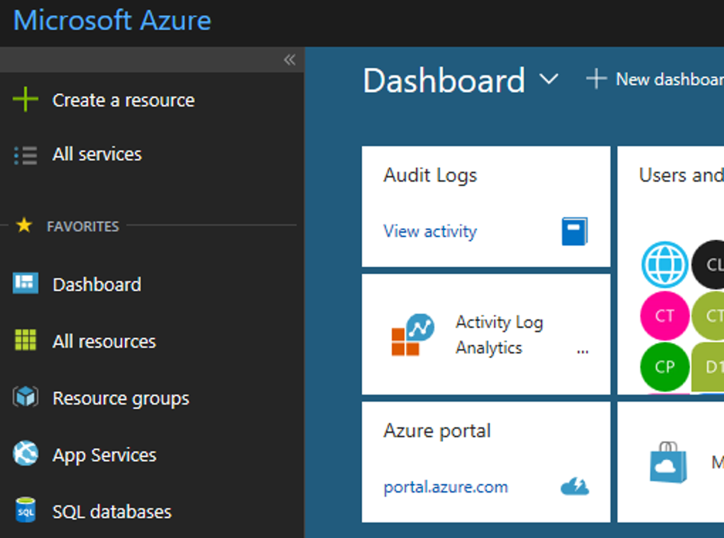
Secure and well-managed for IT
Productive
Govern
Secure
Policy management
Cost management
Security management
Threat protection
Hybrid
Azure portal
Configure
Protect
Intelligent
Update management, scripting
automation, configuration
Backup and disaster recovery
Trusted
Monitor
App, infrastructure and network monitoring log analytics and diagnostics
Notes:
Built-in Security and Management in Azure
To be successful in the Cloud era, enterprises must have visibility/metrics and controls on every component to pinpoint issues efficiently, optimize and scale effectively, while having the assurance the security, compliance and polices are in place to ensure the velocity.
Start in the middle with the Azure portal
- With Azure you get enterprise grade management capabilities built-in to the platform – all services and resources together in a single, easy-to-use portal. You can create dashboards, use the friendly search and intuitive menus, quick start resource templates, and more.
- With a single platform, you get integrated and interconnected tools and data, with unified metrics and alerts across your services. So you don’t have to go to different portals with different datasets.
- Using out-of-the-box tools (like Azure Advisor, Azure Service Health, and Cost Management + Billing), you can optimize and right-size your investment and get personalized recommendations to enhance your experience.
Expand to the 5 areas of security and management
5 main areas:
Secure: While Azure is trusted and secure platform, you as a customer have your own security settings you need to manage. You also need to be able to protect your individual machines against threats and monitor the security posture of your system.
Protect: Your VMs and applications in the cloud need to be backed up and protected in the event of data loss. With disaster recovery from on-prem to the cloud, or from one cloud to another, you can avoid downtime and keep your applications up and running.
Monitor: Every operations manager and every developer needs to be able to see the health and performance of their applications, infrastructure, and network. And seeing insights across all three together in a single dashboard can save time and resources in troubleshooting and preventing issues in the future.
Configure: For managing Azure and hybrid workloads at scale, automation and configuration capabilities help you create runbooks to automate tasks, manage the configuration settings and track changes, and monitor and deploy missing updates. Additionally in Azure you can use PowerShell and Cloud Shell for command line scripting.
Govern: Many customers need a way to look across cloud resources to assess and enforce enterprise-wide standards and policy compliance for security and management. In addition, they need to manage and monitor costs for the cloud, not just in Azure but in other clouds too.
Lastly, Azure gives you the flexibility to manage your hybrid environments with most of these services. And you can choose which areas to invest more in, and how much to consume.
With Azure you have the flexibility to choose what and how to manage your IT.

Slide 10
Leverage a secure and well-managed infrastructure
Compute
Storage
Networking
Management
Virtual machines
Availability sets
VM scale sets
Controlled maintenance
Disks Blob storage File sync
Hot and cold
Virtual networks
VPN, ExpressRoute
Load Balancer
DNS, Traffic Manager
Log Analytics
Cloud Shell
Site Recovery
Security Center
Recent announcements
New
Azure Global VNet Peering
Azure Availability Zones
Migration to Azure
Notes:
Taking a deeper look at some of the key services that constitute Azure IaaS. We will go into a little bit more detail into each of these services
The four core technologies are Compute, Network, Storage and Management
Compute:
Virtual Machines is no different from the Virtual Machines you run on premise
We will go into the concept of Availability sets that provides you better availability on the platform. Create available solutions. 99.95%
- VM Scale sets, for autoscaling. VM extensions – custom run scripts
Network:
Virtual network similar to on-prem allow VMs to connect on a private network in the cloud. It provides an isolated and secure environment for your applications.
We have different types of connectivity – IPSec VPN or ExpressRoute (private network on a telecom provider, highest level of security)
Bring your own network to Azure, most of the networking technologies you are familiar with are available on Azure
There are different ways to connect to Azure such as VPN, ExpressRoute that we will talk about
We will also talk about features like Load balancing, DNS
What does Traffic manager do – distribute traffic
Storage:
Azure Storage offers different sets of storage services for various business needs. Some of them being disks connecting to a VM or Blob storage for unstructured data
VMs connect to Disks – there are different options Standard or Premium disks based on whether you want higher throughput and lower latency
We have object storage for your storage needs. We recently launched also Cool storage if you don’t need frequent access
Management
Management across the these various foundational services. Some of the services including portal, AD, MFA, KeyVault, marketplace.
Security
AD for identity management
ARM management, powerful - templatized

Slide 11
DevOps framework
Mobile DevOps
Mobile back-end services
Cloud and offline data
User authentication
Push notifications
Code repository
Build + deploy
Test cloud
User beta testing
Backlog
Monitor/analytics
Recent announcements
New
Azure Lab Services
Running Jenkins on Azure
Visual Studio App Center - App Center and GitHub integration
Notes:
Remember our earlier statistic that by 2020, the number of mobile devices coming online will reach 1 million per hour? Mobile development couldn’t be a more important response to targeting customers and providing connected experiences across different interaction points.
That’s why we’ve been investing in mobile capabilities to help customers build mobile apps fast across platforms, with continuous integration and continuous deliver.
On the front-end of development, Xamarin helps developer productivity for building mobile apps with C# compiling code across platforms: iOS, Android, Microsoft. Xamarin Test Cloud, provides automated testing to find bugs quickly before you deploy.
With HockeyApp we can manage beta distribution, get real-time crash reports, and engage with customer feedback for continuous integration.
Azure Mobile App Service provides the back-end services that customers require, including offline data sync, user authentication, and push notifications. Mobile App Service is also tool agnostic, so whether you’re using Xamarin/HockeyApp or another tool, you can leverage the mobile back-end services all the same.

Slide 12
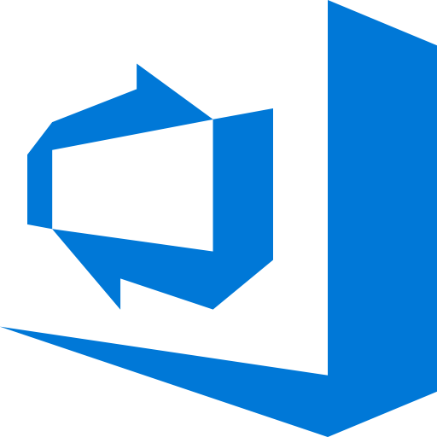







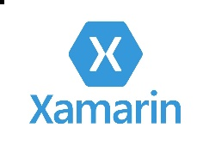


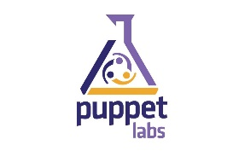

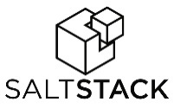



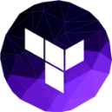









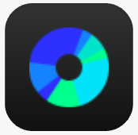










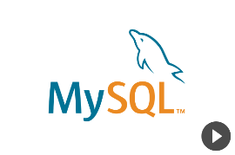









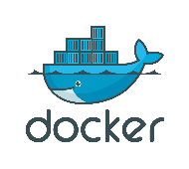



Open source support
DevOps
Management
Applications
App frameworks
& tools
Databases &
middleware
Infrastructure
Notes:
Microsoft has a comprehensive approach to open source in the cloud that spans enabling, integrating, releasing and contributing to open source, with a strong emphasis on ecosystem partnerships
Microsoft Azure is an open and flexible cloud that is all about choice, and allows you to build applications in the cloud the way you want with your choice of tools, applications and frameworks
Microsoft also integrates open source into many of Azure products and services, such as Hadoop and Linux in HDInsight, fluent in OMS or DC/OS, Kubernetes and Docker Swarm in ACS, and has open sourced ACS-Engine

Slide 13
Hybrid
Notes:
Develop and deploy where you want, with the only consistent hybrid cloud on the market. Extend Azure on-premises with Azure Stack.

Slide 14
The only consistent, hybrid cloud
Azure Active Directory
Azure services
Azure data services
Azure security and management
Productive
Hybrid
Common identity
Unified cloud platform
Data
platform
Security and management
Intelligent
Active Directory
Azure
Stack
SQL
Server
On–premises infrastructure
Trusted
Notes:
Hybrid
The strength of the hybrid strategy is about the continuum of capabilities across the offerings, it’s not just about the platform.
Hybrid is more than just being able to move an application into the cloud.
There are critical elements from identity, data, and security and management that have to be addressed.
You don’t have to be stuck in an all-or nothing choice – hybrid gives you the flexibility to move to the cloud when and how you want to.

Slide 15
Azure Stack | an extension of Azure
Productive
Hybrid
Intelligent
At the edge and disconnected
Meet every regulatory requirement
Cloud application model on–premises
Trusted
Notes:
Azure Stack: an extension of Azure
One important aspect of the hybrid approach is Azure Stack.
What is Azure Stack?
It’s the code of Azure that is instantiated on a small footprint, a on-premises server stack.
You can build applications using the same APIs, same capabilities, and the same management portal.
There are three reasons you may want to do that:
First, the disconnected and edge scenarios.
For example, cruise ships roaming the oceans that are not always connected, oil rigs in a remote situation that might not have high bandwidth.
Your application can run in Azure for connected environments and locally on Azure Stack for the disconnected environments.
The second scenario is regulatory.
Where there are specific regulatory requirements about data leaving the country, but there is no Azure data center, you can have Azure Stack to meet local regulatory requirements.
The last one is where you may want to move to cloud-first model but are limited due to restrictions such as having a mainframe application that cannot be moved to the cloud and you need to have it close to the cloud components.
Azure Stack is delivered as an integrated systems. It is delivered through hardware partners such as Dell and HP.
Trusted:
We understand every company, organization, and industry has unique needs and requirements.
That’s why we’re building our global infrastructure to provide the scale and performance needed to bring applications closer to users, keep them running with robust resiliency features, and meet your local data residency and compliance needs.
Microsoft has invested to more than double the number of Azure regions available to customers over the last three years.
We’ve announced 50 regions around the globe, more than any provider – 38 (40 as of April 2) available now, 12 coming soon
In March alone we announced:
Our first cloud regions in the Middle East (UAE - Abu Dhabi & Dubai)
Our intention to be the first global cloud operator to introduce regions in Switzerland (cantons of Geneva and Zurich)
New datacenter regions in Germany
New regions dedicated to the US government
General availability of our France and (as of April 2) Australia (Canberra) regions

Slide 16
Intelligent
Notes:
Create intelligent apps that delight with data-driven experiences. Go quickly from concept to release with Azure data services and artificial intelligence, from image recognition to bot services.

Slide 17

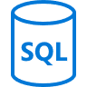



Machine Learning workbench
Productive
Language APIs
Azure SQL DB
Hybrid
AI for every developer and every scenario
Intelligent
Azure Machine Learning
Vison API
Trusted
Azure Bot service
Notes:
Microsoft Azure: the cloud for intelligent solutions
In addition to having the traditional on-premises enterprise data tools—such as SQL Server—Azure provides SQL services that connects data to AI services.
This enables quick adoption of technologies, such as deploying a global mobile application that integrates with facial recognition services.
The ease of integration enables anyone to build solutions like that.
From bot frameworks to cognitive services, you can fundamentally change the way your business goes to market with Microsoft’s power AI platform

Slide 18
Comprehensive deep learning,
machine learning as a service
Productive
Hybrid
Customizable services
VS, ML STUB, Tensor, Caffe
Tools
Bots, Cognitive, ML
Infrastructure and compute
CPU, GPU, FPGA
Intelligent
Azure
Trusted
Notes:
Develop breakthrough apps with built-in intelligence
Take advantage of a comprehensive set of services, infrastructure, and tools to build AI-powered experiences including bots that naturally interact with users and built-in advanced analytics tools, such as R, to make faster predictions.
Elastically scale storage and performance with Azure Cosmos DB, the first globally distributed database service that delivers horizontal scale-out with guaranteed single digit millisecond latency.
Rest assured with managed service capabilities such as built-in monitoring, threat detection, automatic patching, and backups.
Expand your possibilities with an open platform
Build apps for any scenario with familiar technologies of your choice and a comprehensive set of data engines such as PostgreSQL, MySQL, MongoDB and Hadoop.
Leverage advanced analytics and AI services and tools such as Spark, and Jupyter Notebooks.
Build and deploy custom AI models at scale
Work across teams to build, test and manage different versions of your models in production with Azure Machine Learning Studio, Workbench, Experimentation, and Model management. Build rich AI applications with a family of GPUs `optimized for deep learning AI scenarios and run large-scale, massively parallel development with Azure Batch. Debug, test and deploy across platforms with Visual Studio Code.

Slide 19
Build with a platform designed for future growth
App service
DevTest Labs
Logic apps
Cosmos DB
Web, mobile, and API apps
Integrate with your existing toolchain
Workflow & integration
Globally distributed, multi-model database service
Recent announcements
New
Azure Maps
Language Understanding Intelligent Service (LUIS)
Azure Sphere
Notes:
Azure Platform as a service (PaaS) is a complete development and deployment environment in the cloud, with resources that enable you to deliver everything from simple cloud-based apps to sophisticated, cloud-enabled enterprise applications.
PaaS includes infrastructure—servers, storage, and networking—but also middleware, development tools, business intelligence (BI) services, database management systems, and more. PaaS is designed to support the complete web application lifecycle: building, testing, deploying, managing, and updating.
PaaS allows you to avoid the expense and complexity of buying and managing software licenses, the underlying application infrastructure and middleware or the development tools and other resources. You manage the applications and services you develop, and the cloud service provider typically manages everything else.
App Service:
Create web and mobile apps for any platform or device. Integrate your apps with SaaS solutions, connect with on-premises applications, and automate your business processes. Azure runs your apps on fully managed virtual machines (VMs), with your choice of shared VM resources or dedicated VMs.
App Service includes the web and mobile capabilities that we previously delivered separately as Azure Websites and Azure Mobile Services. It also includes new capabilities for automating business processes and hosting cloud APIs. As a single integrated service, App Service lets you compose various components -- websites, mobile app back ends, RESTful APIs, and business processes -- into a single solution.
DevTest Labs:
Azure DevTest Labs is a service that helps developers and testers quickly create environments in Azure while minimizing waste and controlling cost. You can test the latest version of your application by quickly provisioning Windows and Linux environments using reusable templates and artifacts. Easily integrate your deployment pipeline with DevTest Labs to provision on-demand environments. Scale up your load testing by provisioning multiple test agents, and create pre-provisioned environments for training and demos.
Logic apps:
Logic Apps provide a way to simplify and implement scalable integrations and workflows in the cloud. It provides a visual designer to model and automate your process as a series of steps known as a workflow. There are many connectors across the cloud and on-premises to quickly integrate across services and protocols. A logic app begins with a trigger (like 'When an account is added to Dynamics CRM') and after firing can begin many combinations of actions, conversions, and condition logic.
Logic Apps is a fully managed iPaaS (integration Platform as a Service) allowing developers not to have to worry about building hosting, scalability, availability and management. Logic Apps will scale up automatically to meet demand.
Cosmos DB:
Azure Cosmos DB is Microsoft's globally distributed, multi-model database. With the click of a button, Azure Cosmos DB enables you to elastically and independently scale throughput and storage across any number of Azure's geographic regions. It offers throughput, latency, availability, and consistency guarantees with comprehensive service level agreements (SLAs), something no other database service can offer.
Any web, mobile, gaming, and IoT applications that need to handle massive amounts of reads and writes on a global scale with low response times for a variety of data will benefit from Azure Cosmos DB's guaranteed availability, high throughput, low latency, and tunable consistency.
Some other recent enhancements to Azure include:
- Scalable quantum computing: https://www.microsoft.com/en-us/quantum/default.aspx
Azure Container Instances (Kubernetes or Docker): https://azure.microsoft.com/en-us/blog/announcing-azure-container-instances/
- Cosmos DB and Azure Functions native integration: https://azure.microsoft.com/en-us/blog/azure-cosmosdb-database-for-serverless-era/

Slide 20


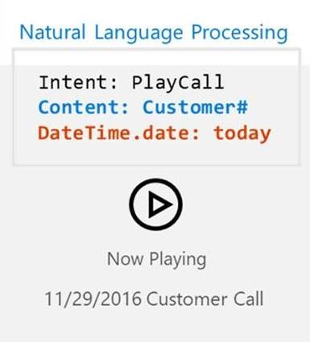
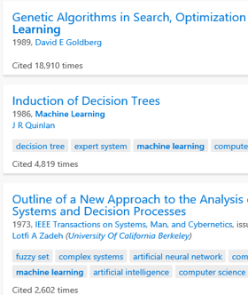
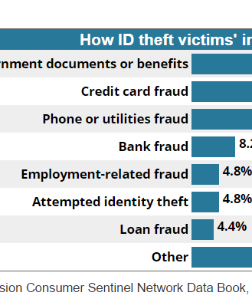

Intelligent algorithms to see, hear, speak, understand and interpret your user needs in more natural ways
Vision
Speech
Language
Knowledge
Search
From faces to feelings, allow apps to understand images and video
Hear and speak to users by filtering noise, identifying speakers, and understanding intent
Process text and learn how to recognize what users want
Tap into rich knowledge amassed from the web, academia, or your own data
Locate relevant information among billions of web pages, images, videos, and news with Bing APIs
Show me what is in the image
Convert this text to speech please…
Play today’s conference call…
Top publications in AI...
Fraud prevention results…
Notes:
Lastly, Azure supports a number of artificial intelligence capabilities. Artificial Intelligence is no longer an exotic concept. Rather, it’s embedded into experiences we have every day. Siri and Cortana for example help us complete tasks faster and on the go.
Another example is Dominos. They recently went through a massive digital transformation to improve their brand perception and engage customers in new ways, and they launched a series of “app-less apps” or rather social/chat/text apps where you can order pizza through natural language interaction through channels like Twitter, and SMS. Not only are they reaching people in channels unexplored by any other pizza company, they’re building a positive brand image as a company that’s truly centered on customers.
With Cognitive Services and the Bot Framework, we’re providing the APIs and SDKs to help you embed these experiences within your Azure applications.
Cognitive Services includes APIs for vision, speech, language, knowledge, and search.
Bot Framework includes a connector, to text/sms, O365, Slack, etc., an open source SDK, and a directory of public bots.

Slide 21
Simplify IoT with preconfigured solutions
Azure IoT Suite
Street sweepers
Buses
Cows
Vending machines
Buildings
Device connectivity & management
Postboxes
Data ingestion and command & control
Auto
Oil equipment
Stream processing & predictive analytics
Aircraft
Electric charging stations
Factory floor
Workflow automation and integration
Power plant
IoT
Racing
Dogs
Dashboards and visualization
Medical devices
Preconfigured solutions
Trucks
Power tools
Mining equipment
Oil distribution
Remote monitoring
Elevators
Predictive maintenance
Smart meters
Surveillance
Smart grids
Engines
Connected factory (new)
Notes:
While there are a lot of interesting IoT scenarios unfolding in the consumer space, based on our experience in working with customers and partners we see the majority of IoT value being enabled in the commercial space.
This is backed by a recently released McKinsey report that states that 70% of the value enabled by IoT will come from B2B scenarios.
Whether its Rockwell Automation that is helping its oil and gas customers improve efficiency by monitoring supply chain assets, or ThyssenKrupp elevators that is doing predictive maintenance on elevators to prevent unscheduled downtime for their customers, or the Stanford Linear Accelerator Center (SLAC) that is using IoT to continuously monitor various sensors of the linear accelerator to anticipate problems, take action and prevent failure; organization of all types are starting to harness the value of IoT to transform themselves.
Of course, as a solution provider you could very well be working with a customer that's creating a consumer product, let's say a car manufacturer. However, the value you'll be providing in this B2B2C scenario is helping that organization build an enterprise grade IoT solution so they can launch their products.
Our focus here is simply to enable build enterprise grade internet of their things solutions for your customers. Our goal is to provide you the best platform to do this.

Slide 22
Trusted
Notes:
Join startups, governments, and 90 percent of Fortune 500s that trust the Microsoft Cloud for security, privacy, transparency, and the most compliance coverage of any cloud provider.

Slide 23
Productive
Hybrid
Intelligent
50
Azure regions
Trusted
Notes:
Trusted
Azure is continuing expand its infrastructure footprint around the globe.
In fact, Microsoft is the first cloud provider to put data centers in South Africa.
Right now, we’re at 50 Azure regions—which is more than AWS and Google combined.
The approach Azure takes is different as it is important for enterprise customers to have data in region, close to employees, close to customers as well as have unique data handling capabilities.
Learn more:
For more information on how we run and secure the datacenters, there are more resources online.
Tours are available for our datacenters if you wish to see the capabilities and technologies that are in use in Azure.
Trusted:
We understand every company, organization, and industry has unique needs and requirements.
That’s why we’re building our global infrastructure to provide the scale and performance needed to bring applications closer to users, keep them running with robust resiliency features, and meet your local data residency and compliance needs.
Microsoft has invested to more than double the number of Azure regions available to customers over the last three years.
We’ve announced 50 regions around the globe, more than any provider – 38 (40 as of April 2) available now, 12 coming soon
In March alone we announced:
Our first cloud regions in the Middle East (UAE - Abu Dhabi & Dubai)
Our intention to be the first global cloud operator to introduce regions in Switzerland (cantons of Geneva and Zurich)
New datacenter regions in Germany
New regions dedicated to the US government
General availability of our France and (as of April 2) Australia (Canberra) regions

Slide 24
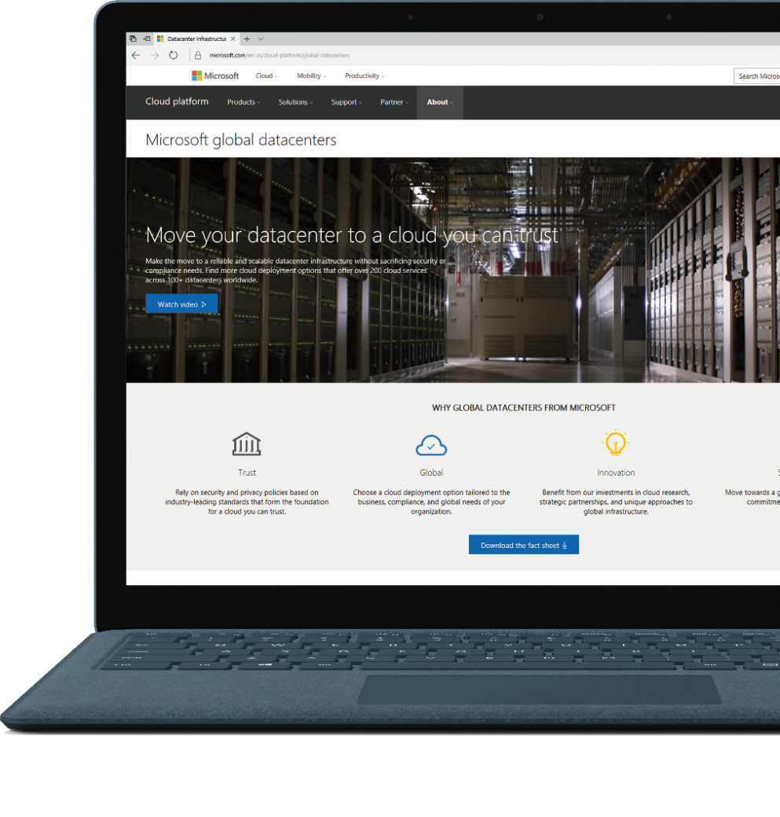
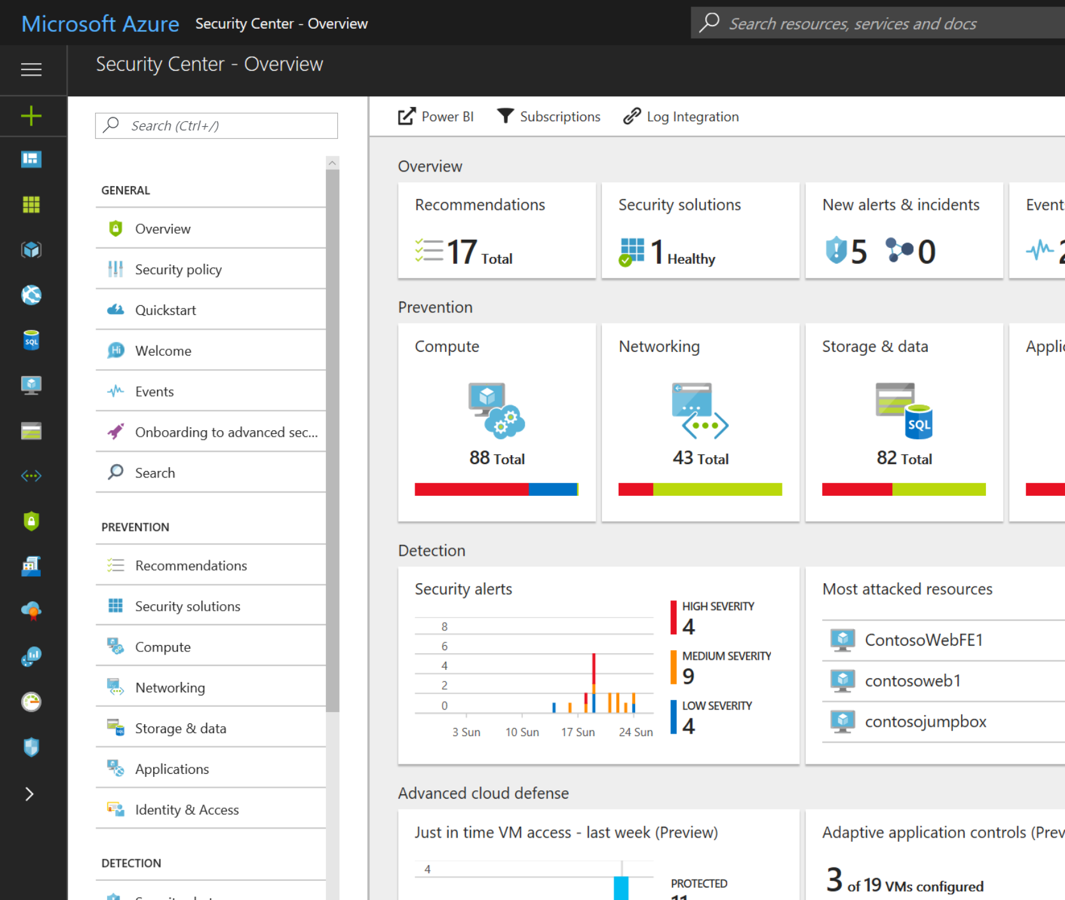
Productive
Azure
Security Center
Hybrid
Protection through best practices
Detect threats and attacks
Remediate issues
Intelligent
Trusted
Notes:
Understand security state across on-premises and cloud workloads
Get a unified view of security across all of your on-premises and cloud workloads. Automatically discover and onboard new Azure resources, and apply security policies across your hybrid cloud workloads to ensure compliance with security standards. Collect, search, and analyze security data from a variety of sources, including firewalls and other partner solutions.
Find vulnerabilities and remediate quickly
Continuously monitor the security of your machines, networks, and Azure services using hundreds of built-in security assessments or create your own. Use actionable security recommendations to remediate issues before they can be exploited.
Limit your exposure to threats
Enable adaptive threat protections to reduce exposure to attacks. Block malware and other unwanted code by applying application controls adapted to your specific workloads and powered by machine learning. Enable just-in-time, controlled access to management ports on Azure VMs to drastically reduce surface area exposed to brute force and other network attacks.
Detect and respond swiftly to attacks
Use advanced analytics and the Microsoft Intelligent Security Graph to get an edge over evolving cyber attacks. Leverage built-in behavioral analytics and machine learning to identify attacks and zero-day exploits. Monitor networks, machines, and cloud services for incoming attacks and post-breach activity. Streamline investigation with interactive tools and contextual threat intelligence.

Slide 25
Azure covers 74 compliance offerings
The deepest and most comprehensive compliance coverage in the industry
Global
ISO 27001:2013
ISO 27017:2015
ISO 27018:2014
ISO 22301:2012
ISO 9001:2015 ISO 20000-1:2011
SOC 1 Type 2
SOC 2 Type 2
SOC 3
CSA STAR Certification
CSA STAR Attestation
CSA STAR Self-Assessment WCAG 2.0
US Gov
FedRAMP High
FedRAMP Moderate EAR
DoD DISA SRG Level 5
DoD DISA SRG Level 4 DoD DISA SRG Level 2 DFARS
DoE 10 CFR Part 810 NIST SP 800-171
NIST CSF
Section 508 VPATs
FIPS 140-2 ITAR
CJIS
IRS 1075
Industry
PCI DSS Level 1
GLBA
FFIEC Shared Assessments FISC (Japan) APRA (Australia)
FCA (UK) MAS + ABS (Singapore)
23 NYCRR 500 HIPAA BAA HITRUST
21 CFR Part 11 (GxP) MARS-E NHS IG Toolkit (UK)
NEN 7510:2011 (Netherlands)
FERPA
CDSA
MPAA
FACT (UK) DPP (UK) SOX
Regional
Argentina PDPA
Australia IRAP Unclassified Australia IRAP Protected
Canada Privacy Laws China GB 18030:2005 China DJCP (MLPS) Level 3
China TRUCS / CCCPPF
EN 301 549
EU ENISA IAF EU Model Clauses EU – US Privacy Shield GDPR Germany C5
Germany IT-Grundschutz workbook India MeitY
Japan CS Mark Gold
Japan My Number Act Netherlands BIR 2012 New Zealand Gov CIO Fwk
Singapore MTCS Level 3
Spain ENS
Spain DPA UK Cyber Essentials Plus UK G-Cloud UK PASF
https://aka.ms/AzureCompliance
Notes:
See http://aka.ms/AzureCompliance for more information.

Slide 26
Most comprehensive resiliency and best SLA
Industry-only
Industry-leading high availability SLA
Industry-leading disaster recovery
VM SLA
VM SLA
VM SLA
Regions 42
99.9%
99.95%
99.99%
Region 1
Region 2
Single VM
Availability sets
Availability zones
Region pairs
Protection with Premium Storage
Protection against failures within datacenters
Protection from entire datacenter failures
Protection from disaster with Data Residency compliance
Notes:
Comprehensive set of native business continuity solutions
industry’s only single VM SLA.
99.9% SLA guarantee on Single Instance Virtual Machines which are backed by Premium Storage
High availability across datacenters
Availability zones – protect against loss of entire datacenters, 99.99% SLA at GA
Combination – higher than any other vendor
Disaster recovery and backup solutions
DR via Azure Site Recovery provides orchestrated failover.
Only Azure provides this comprehensive level of service

Slide 27
Microsoft Azure Government Roadmap

Slide 28

Announcing June
New resources added to GearUp
We have posted the latest Azure Government EBC Presentation deck to the Overview tab. This is a great resource for your customer meetings with all the latest Azure Gov information. This modular deck spans across the Azure pillars and includes partner and customer case studies and the latest service announcements!
Just posted to the Customer Ready tab new assets in the Content Pack. These assets are in printable form and ready to be downloaded.
At the Build Conference Microsoft shared the breadth of innovation coming to Azure--across Azure Stack, data and analytics solutions, IoT and more. Government customers can continue to count on this rapid pace of commercial innovation coming to Azure Government over time, as services becoming generally available, throughout the year.
Azure API Management is now generally available in Microsoft Azure Government. API Management is a turnkey, full-lifecycle solution for publishing APIs to external and internal consumers. Customers use API Management to quickly create consistent and modern API gateways for existing back-end services hosted anywhere. API Management helps you secure and protect APIs and provides insights into API usage and health
New partner video’s added the Azure YouTube channel
Want an easy way to explain what Azure Government is? This 3 minute animation overview will answer quickly all you need.
Cloud Solution Provider Program for Azure Government
Azure Government Overview for Partners
How to use Azure Government for the Defense Industrial Base
Live Webcast June 26th, 2018 | Reaching New Frontiers: Data and AI with Azure Government
Please share the registration with your customers, partners and amplify through your field and local social channels.
Notes:
Azure Government announced two new Azure Government Secret regions for classified data coming soon, bringing our US government-only datacenter regions count to a total of 8. We also announced Azure Stack integration with Azure Government in mid-2018, which will unlock a wide range of hybrid use cases, and growing connectivity options with new ExpressRoute locations. We’re also releasing new capabilities to accelerate developer and IT productivity and efficiency with DevTest Labs, Logic Apps and Power BI embedded.

Slide 29
Announcing May
Announcing the launch of Azure M-series VMs with up to 4TB RAM in USGov Virginia region
Azure M-series VMs offer memory up to 4 TB on a single VM with configurations of 64 or 128 hyper-threaded vCPUs, powered by Intel® Xeon® 2.5 GHz E7-8890 v3 processors.
We’re also excited to announce that Azure is the first hyperscale cloud provider to offer VMs with up to 4TB optimized for large in-memory database workloads in a sovereign cloud.
Announcing new GPU’s in Azure Government with NV Series
With these powerful visualization GPUs in Azure Government, customers can visualize graphic-intensive workflows to get superior graphics capability and run single precision workloads such as encoding and rendering.
Citrix Cloud coming soon to Azure Government
Specifically, this means that the management plane for Citrix Cloud XenApp and XenDesktop service will soon be available on Azure Government, enabling customers to use these innovative services to provide secure remote access to employees with the world-class security and broad compliance coverage of Microsoft’s government-only cloud.
Notes:
Azure Government announced two new Azure Government Secret regions for classified data coming soon, bringing our US government-only datacenter regions count to a total of 8. We also announced Azure Stack integration with Azure Government in mid-2018, which will unlock a wide range of hybrid use cases, and growing connectivity options with new ExpressRoute locations. We’re also releasing new capabilities to accelerate developer and IT productivity and efficiency with DevTest Labs, Logic Apps and Power BI embedded.

Slide 30


Azure government regions
Seattle ExpressRoute
New York ExpressRoute
8
US Gov Iowa
Chicago ExpressRoute
Gov
Regions
Announced
Silicon Valley
ExpressRoute, CAP
US DoD East
US Gov Arizona
Washington D.C. ExpressRoute, CAP
US DoD Central
US Gov Texas
Phoenix
ExpressRoute
US Gov Virginia
8
Dallas
ExpressRoute, CAP
San Antonio
ExpressRoute
ExpressRoute Locations
Announced
ExpressRoute Documentation
Notes:
We are announcing several important advances. We are adding two more regions to the Azure Government region count, bringing the number of dedicated regions to a total of eight. As announced last fall, these regions will be enabled for data classified Secret and provide commercial-grade hyperscale cloud services with the highest availability, deepest compliance, and fastest innovation available to support the most critical of U.S. Government missions. ​
​
Government customers can take advantage of growing connectivity options with two new ExpressRoute sites coming soon at San Antonio and Phoenix, providing choice and convenience when connecting between on-premises and virtual resources in the cloud and enabling reliable connection for scenarios like data migration, disaster recovery or other high-availability needs. We have added key networking services such as VNet service endpoints for storage and SQL and Network Watcher for more secure building of applications and monitoring. ​​

Slide 31






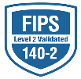




































The most trusted and compliant cloud
GLOBAL
ISO 27001
ISO 27018
ISO 27017
ISO 22301
ISO 9001
SOC 1
Type 2
SOC 2
Type 2
SOC 3
CSA STAR
Self-Assessment
CSA STAR
Certification
CSA STAR
Attestation
US GOV
Moderate
JAB P-ATO
High
JAB P-ATO
DoD DISA
SRG Level 2
DoD DISA
SRG Level 4
DoD DISA
SRG Level 5
SP 800-171
FIPS 140-2
Section 508 VPAT
ITAR
CJIS
IRS 1075
INDUSTRY
PCI DSS
Level 1
CDSA
MPAA
FACT
UK
Shared
Assessments
FISC
Japan
HIPAA/ HITECH Act
HITRUST
GxP
21 CFR Part 11
MARS-E
IG Toolkit
UK
FERPA
GLBA
FFIEC
REGIONAL
Argentina PDPA
EU
Model Clauses
UK
G-Cloud
China
DJCP
China
GB 18030
China
TRUCS
Singapore
MTCS
Australia
IRAP/CCSL
New
Zealand
GCIO
Japan My
Number Act
ENISA
IAF
Japan CS Mark Gold
Spain
ENS
Spain
DPA
India
MeitY
Canada
Privacy Laws
Privacy
Shield
Germany IT
Grundschutz
workbook
Trust Center

Slide 32

Comprehensive and open cloud for State and Local government
Meeting security and compliance requirements for state and local government.
Largest number of states for CJIS covering 2/3 of the population.
CJIS States
Notes:
With Office- 30 total CJIS states
70% of US population covered

Slide 33

ATO Blueprint Program
Guidance, deployment support, and automation accelerating compliance
Customized for each participating agency
Onsite resources to support ATO for dozens of mission-critical applications this fiscal year
50-80%
Decrease in FISMA/FedRAMP Authorization Time
For latest Blueprint: https://aka.ms/azureblueprint

Slide 34

Azure Security & Compliance Blueprint Program
Turn-key solutions and support tailored to the needs of Government/DoD customers:
Expertise
Governance Architecture
aka.ms/AzureGovBlueprint
Automation
Partnership
4-pillar program that enables customers to deploy secure and compliant applications in less time, and at a lower cost, than is possible with any other platform, architecture, or environment.

Slide 35

FedRAMP
39 Azure Government services authorized
FedRAMP JAB Authorized
In-Progress FedRAMP Audit Authorizations
Active Directory
API Management
App Service
Application Gateway
Automation
Azure Information Protection
Azure Monitor
Azure Portal
Azure Resource Manager
Azure Service Manager (RDFE)
Backup
Batch
Cosmos DB
Cloud Services
Event Hubs
ExpressRoute
Functions
HDInsight
IoT Hub
Intune
Key Vault
Load Balancer
Log Analytics
Media Services
Notification Hubs
Power BI
Redis Cache
Scheduler
Service Bus
Service Fabric
Site Recovery
SQL Data Warehouse
SQL Database
SQL Server Stretch Database
Storage
StorSimple
Traffic Manager
Virtual Machine Scale Sets
Virtual Machines
Virtual Network
VPN Gateway
Workflow
Power BI Embedded

Slide 36

Azure Government
→
Azure Government site
https://azure.com/gov
Resources
Azure Government blog
https://aka.ms/govblog
→
→
Azure Government free trial https://aka.ms/azuregovtrial
Azure Government documentation
https://aka.ms/azuregovdocs
→
→
Azure Government DC user community
https://meetup.com/DCAzureGov

Slide 37
Notes:
We’ve gone through a journey today, through the various capabilities of Azure that support your path toward digital transformation. We’re here to partner with you as you continue to innovate and transform. Thank you.

